Slide 1
NBA Data Analysis:
What Factors Affect Winning?
By: Paul Gibson and Aadi Dodda
Group #47
CS2316

Slide 2
Project Purpose and Design: P
Why We chose this project:
We are both NBA fans and recognized the data-rich environment of the sport
NBA teams use basketball analytics in order to make decisions such as prioritization in training
Expected Results:
Offensive efficiency would be a stronger prediction of winning than defensive
Three-point shooting would have a strong correlation to team success
High scoring players will be on some of the most winning teams

Slide 3
Datasets(A)
Downloaded Dataset:
A downloaded player dataset from sports-statistics.com with 24,625 rows and 52 columns, which gave us detailed player statistics and helped us study how top scorers relate to team success.
NBA API Dataset:
Installed and used nba_api in python which gave us advanced team metrics such as win percentage, offensive rating, defensive rating used in modern-day NBA analytics.
Basketball Reference:
We pulled team shooting data from Basketball Reference and extracted the table that contained shooting percentages and distance-based shot data. We chose the this because it added location-based shooting data, which let us study whether where teams shoot from matters as much as how well they shoot.

Slide 4
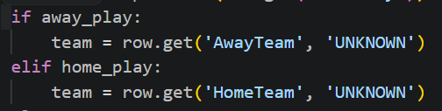
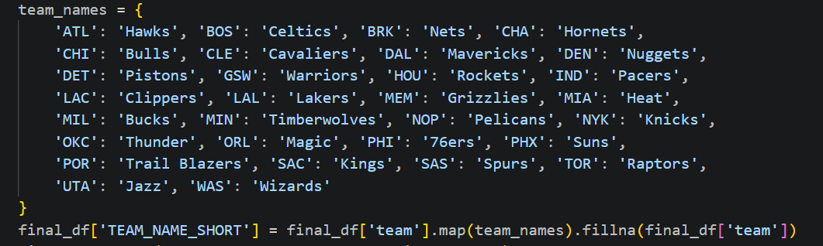
Data Cleaning Process: P
3 main inconsistencies found in our data:
Missing team values in Downloaded dataset
  Default missing team values as ‘UNKNOWN’
  Using .get() funtion
Team names were listed differently across all datasets
  After each dataset had been collected, the team names were mapped to a ‘TEAM_NAME_SHORT’ column
    Insures consistent reference points to each team across all datasets
HTML dataset contained redundant information in separate columns
  Combined layup and dunk stats into the columns ‘Close Shots Made’ and ‘Close Shots %FGA’

Slide 5
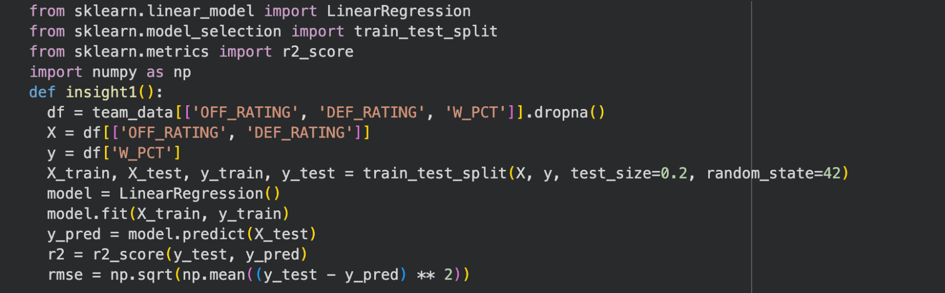
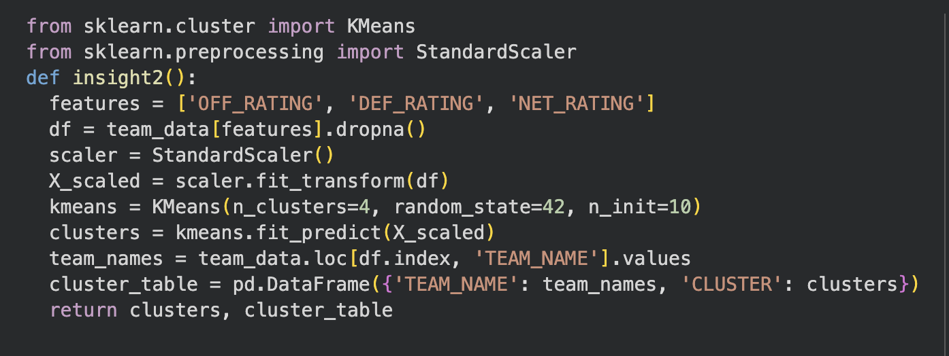
Insights A
Used linear regression to predict team win percentage from offensive rating and defensive rating. The model performed very well, with an R-squared of 0.959 and RMSE of 0.028, and the formula showed that offensive rating had a slightly stronger positive effect on winning than defensive rating had a negative effect.
Used KMeans clustering to divide NBA teams into four groups based on offensive rating, defensive rating, and net rating. The clustering revealed natural performance tiers and showed that even without labeling teams in advance, the data naturally separated them into meaningful performance groups.

Slide 6
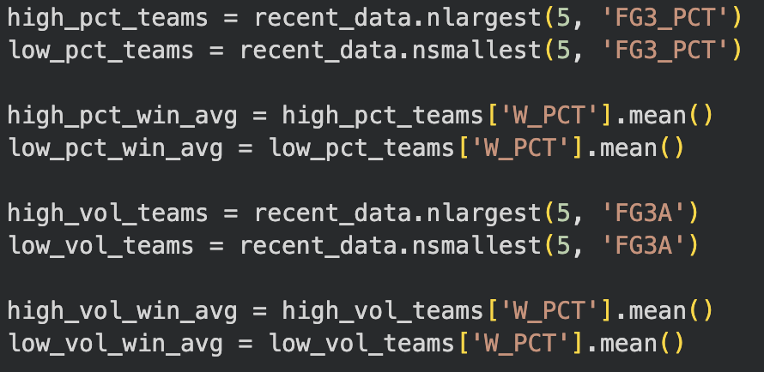
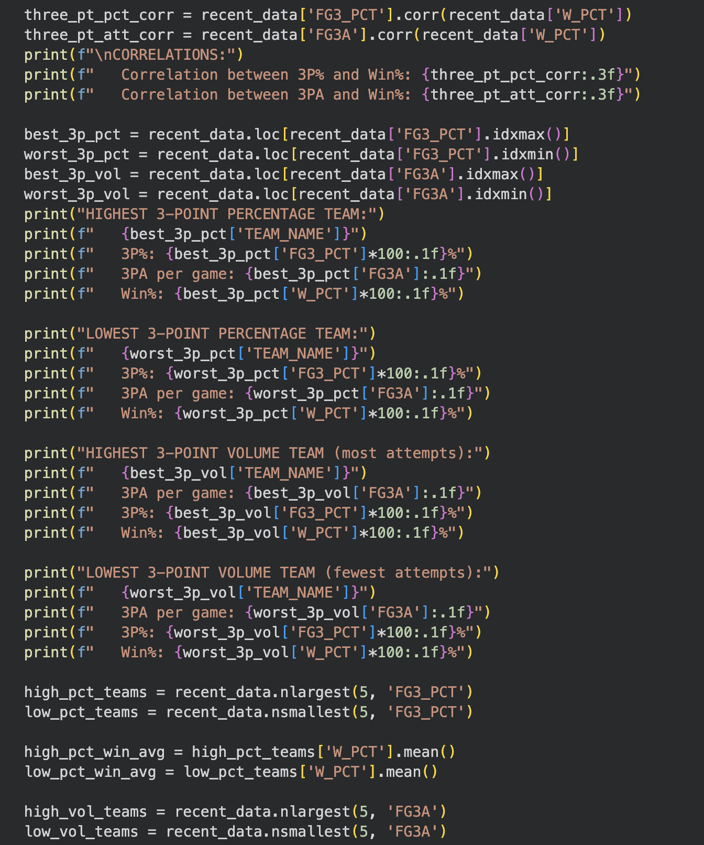
Insights Continued P
3. Do High-Scoring Stars Guarantee Winning? We tested whether teams with top scorers also had better records. The correlation between top scorer total points and team win percentage was 0.400 and shows that scoring volume alone is not enough to explain team success. The best team with a top-15 scorer in the sample was the Boston Celtics with Jayson Tatum at 74.4% win rate, while the worst was the Utah Jazz with Donovan Mitchell at 20.7% win rate, showing that great scorers can still play on weak teams.
4. Three-Point Accuracy vs Three-Point Volume= One of our strongest findings was that three-point percentage mattered much more than three-point volume. The correlation between 3P% and win percentage was 0.670, while the correlation between 3PA and win percentage was only 0.130. The top five teams in three-point accuracy averaged a 60.2% win rate, while the bottom five averaged only 33.7%, which is a much bigger difference than the gap between high-volume and low-volume three-point teams.

Slide 7
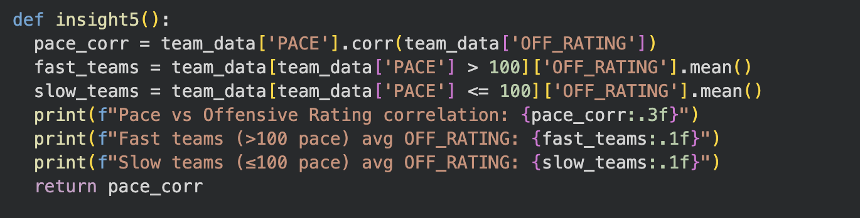
Insight 5 A
Pace Did Not Matter Much
We also tested whether playing faster led to better offense. The correlation between pace and offensive rating was -0.031, and fast teams averaged an offensive rating of 114.3, compared with 114.0 for slower teams. That means pace had almost no relationship with offensive efficiency in our data, so simply playing faster did not appear to make teams meaningfully better on offense.

Slide 8
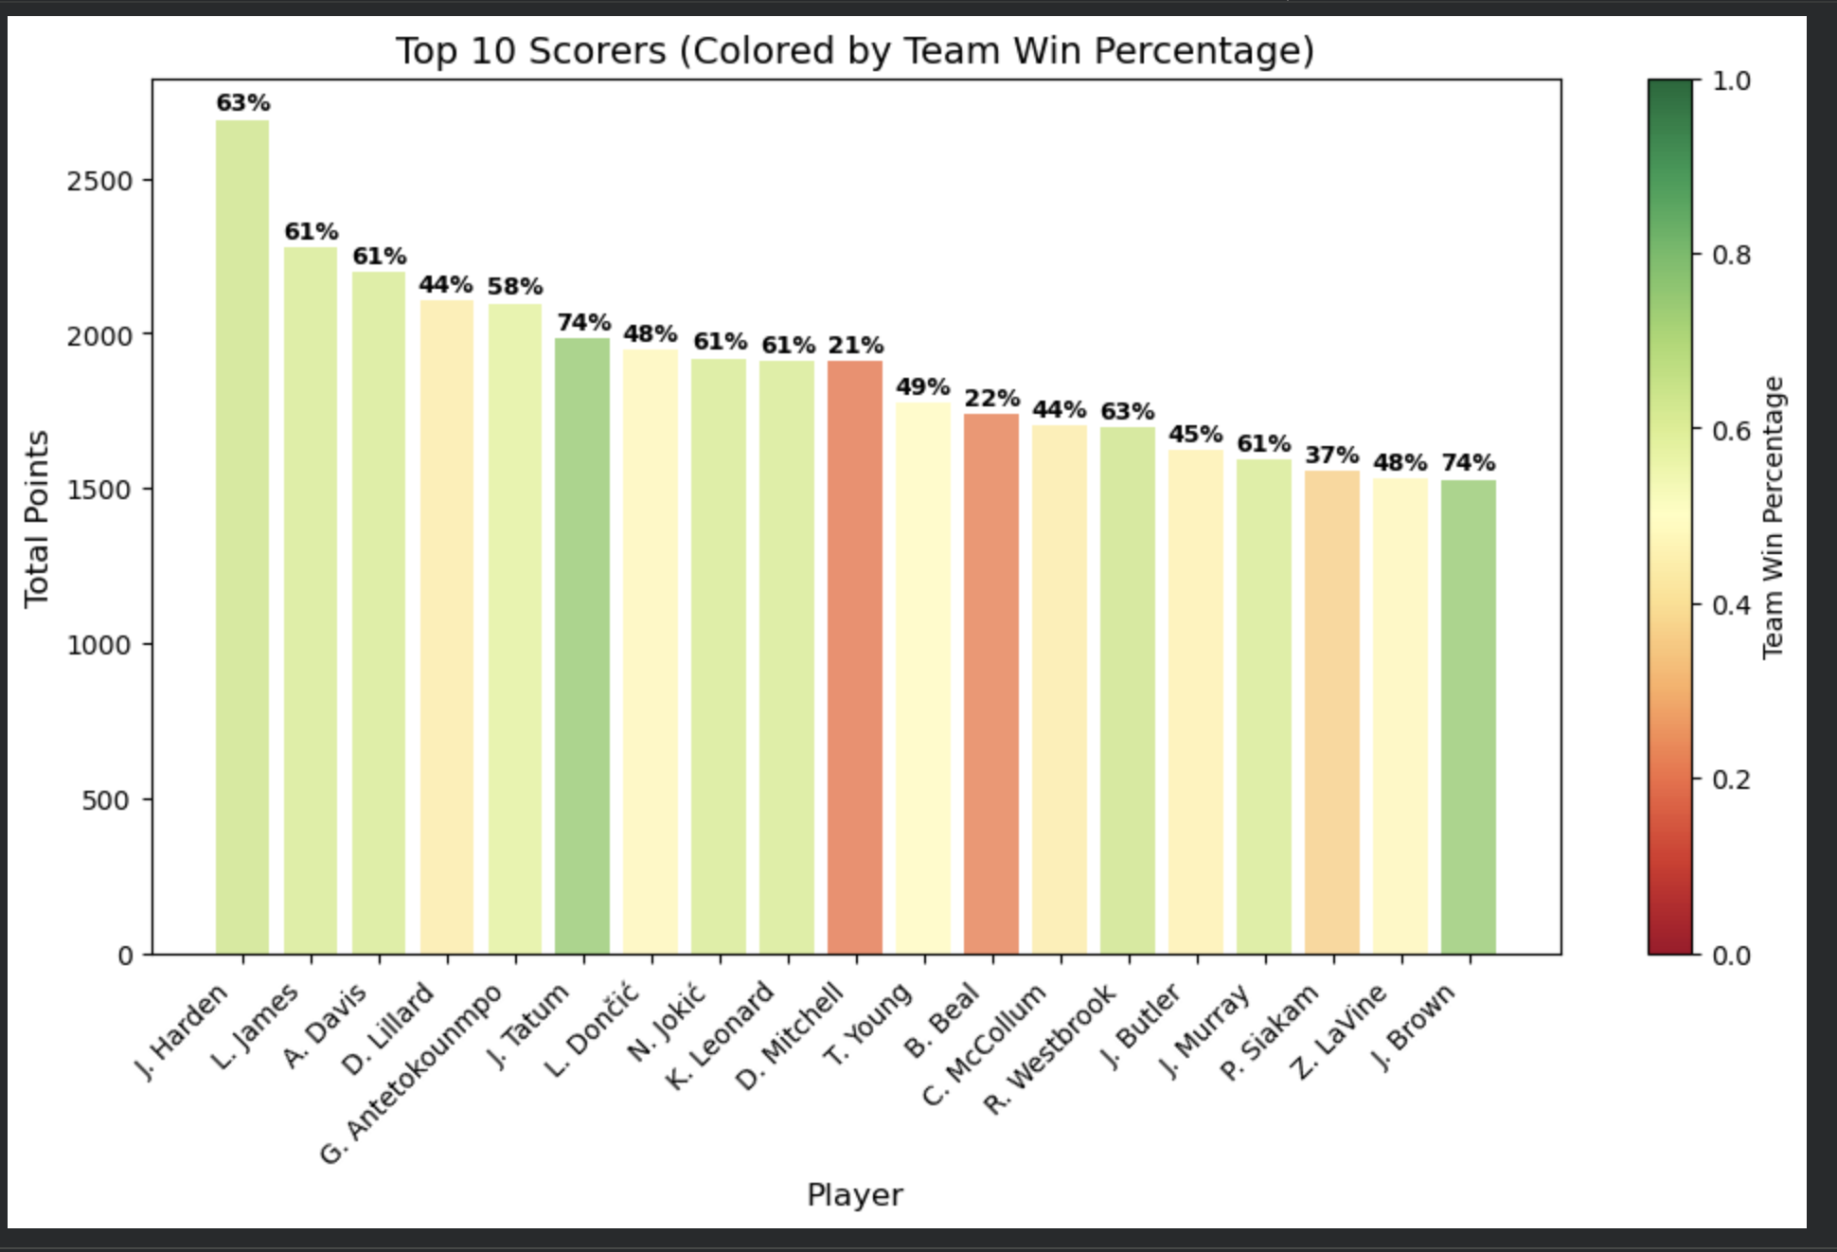
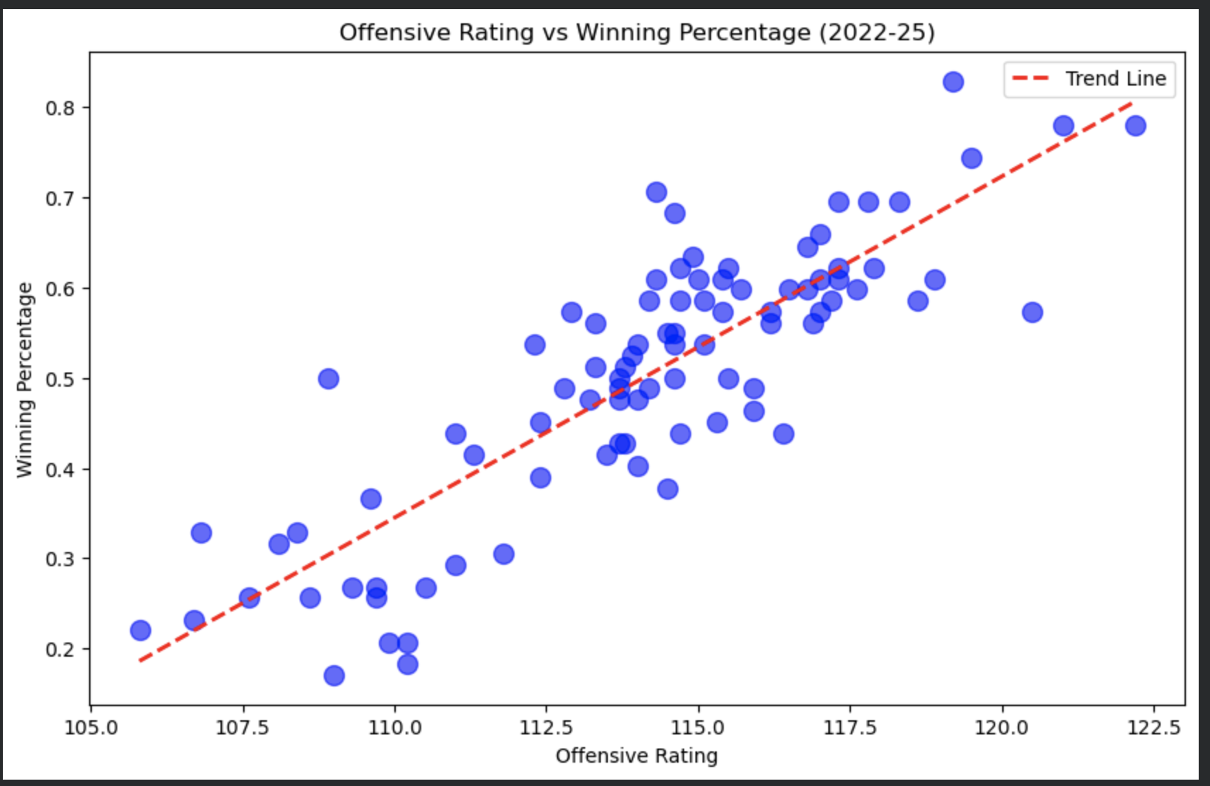
Visualizations
Offensive Rating Vs. Winning Percentage A
This scatter plot shows a clear positive relationship between offensive rating and win percentage. Each point represents an NBA team, and the trend line shows that teams with stronger offense tend to win more games. This visual supports our first insight and makes the regression result easier to see.
Bar chart of top scorers colored by team win percentage P
This chart shows the top scorers, but the bar colors reflect how successful their teams were. Some players scored at a very high level while playing on teams with poor win percentages, which shows that individual scoring does not automatically lead to team success. This visual challenges the idea that the best scorer is always the main reason a team wins.

Slide 9
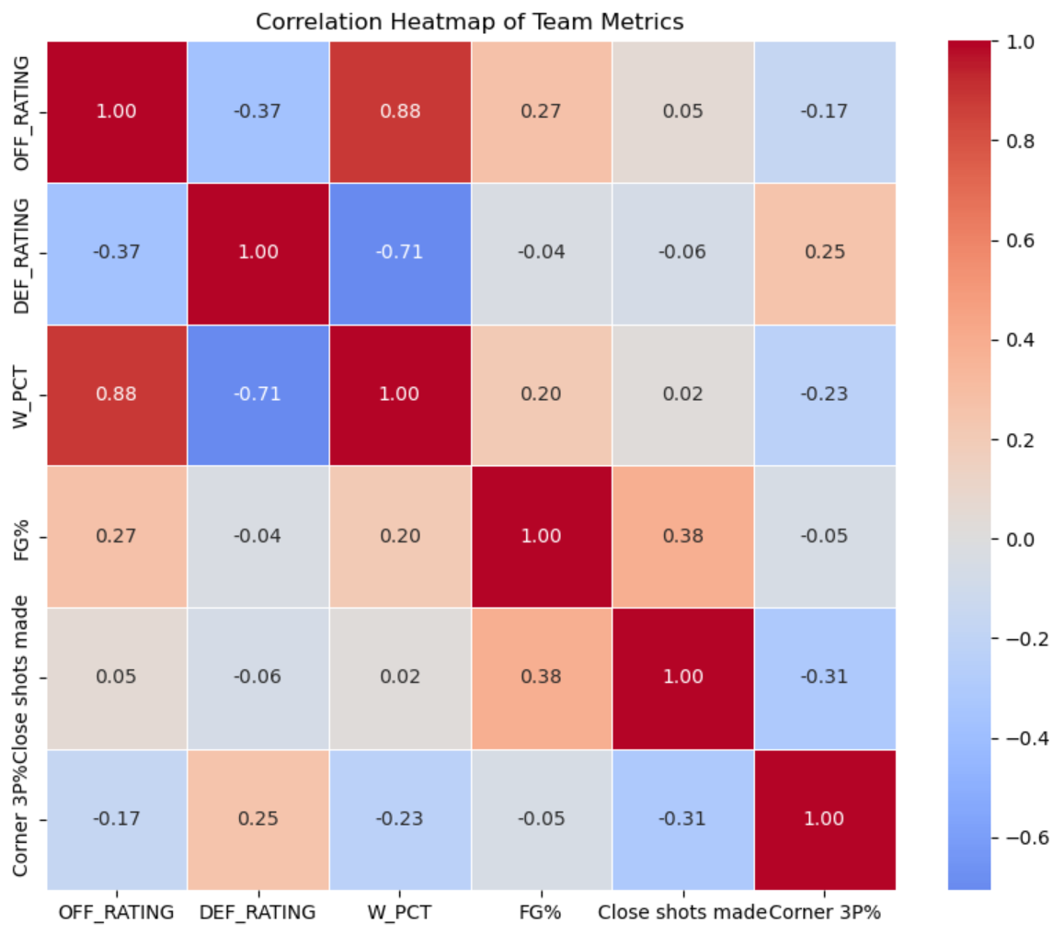
Visualizations (cont.)
Correlation Heatmap of Team Metrics P
This heatmap visualizes correlations between API team stats (OFF_RATING, DEF_RATING, W_PCT, 3P%) and HTML shooting metrics (FG%, Close shots made, Corner 3P%). Dark red indicates strong positive correlation (e.g., OFF_RATING and W_PCT), while dark blue indicates negative correlation (e.g., DEF_RATING and W_PCT). The visualization reveals that three-point percentage correlates more strongly with winning than close shots made, supporting modern NBA analytics that emphasize spacing and efficiency.

Slide 10
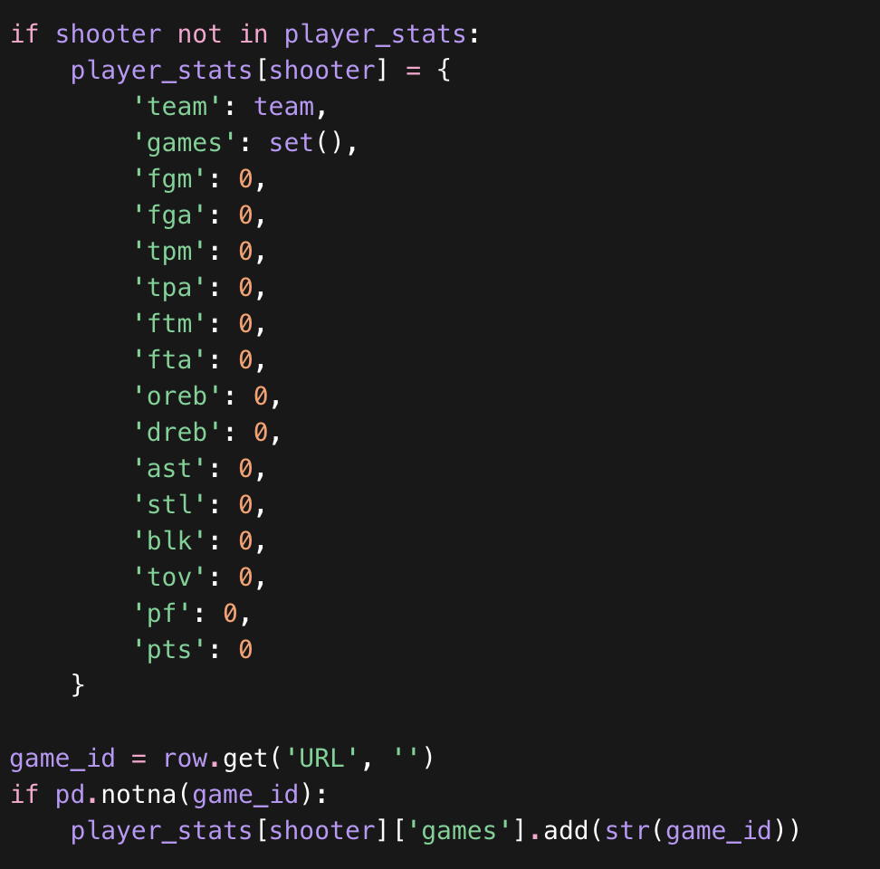
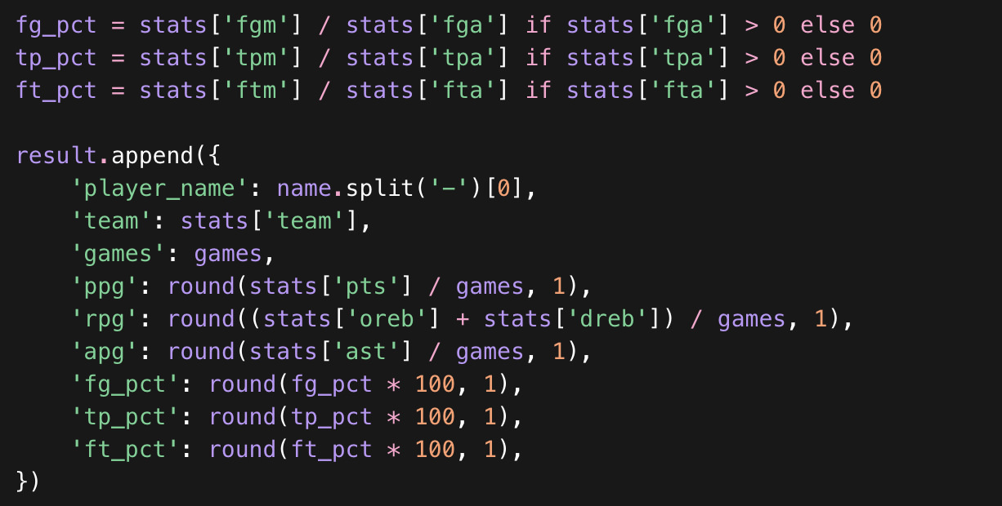
What We Learned Beyond Class
1. Use of SeaBorn Module for Visualization 3: P
Created for specific data interpretation and visual creation, Allows heat map creation in one line of code instead of manually piecing together each part, Automatically adds colorbar, and Adds correlation numbers with inclusion of one parameter instead of needed nested loops
2. A Turning raw event totals into new basketball metrics: In our play-by-play parser, we built a player_stats dictionary from scratch and updated it row by row using fields like Shooter, Assister, Blocker, Rebounder, FreeThrowShooter, and TurnoverPlayer. We also used a set to store each player’s game IDs so we could correctly count games played without duplicates, and then converted those raw totals into new metrics like PPG, RPG, APG, SPG, BPG, TPG, FPG, FG%, 3P%, and FT%. That was more advanced than just filtering rows or calculating one simple column because we were reconstructing player-level statistics from raw game events.

Slide 11
Conclusion P
Our hypothesis was mostly supported, but not completely. We were right that offensive efficiency was a stronger predictor of winning than defense: in our regression model, offensive rating had a slightly stronger impact on win percentage than defensive rating, and together those two metrics explained team success extremely well with an R² of 0.959.
We were also right that three-point shooting strongly related to team success, but the key detail is that accuracy mattered much more than volume. 3P% had a 0.670 correlation with win percentage, while 3PA had only a 0.130 correlation, so teams did not win just because they took a lot of threes—they won when they made them efficiently.
Where we were partly wrong was the idea that high-scoring players would mostly be on the best teams. Our results showed only a moderate relationship between a team’s top scorer and winning, which means elite scorers helped, but they were not enough by themselves to drive team success. Overall, the project showed that balanced team efficiency and shooting quality mattered more than star scoring alone.

Slide 12
Sources
Downloaded Dataset Source:
https://sports-statistics.com/sports-data/nba-basketball-datasets-csv-files/
Web Collection #1 Source:
NBA.com
Web Collection #2 Source:
https://www.basketball-reference.com/leagues/NBA_2025.html#all_shooting_team-opponent

